Slide 1
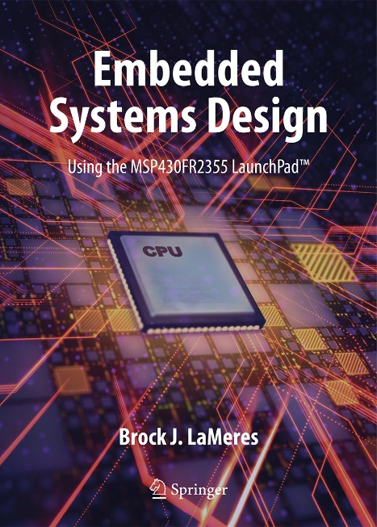

Embedded Systems Design
Chapter 10: The STACK and Subroutines
10.1 The STACK
Brock J. LaMeres, Ph.D.

Slide 2
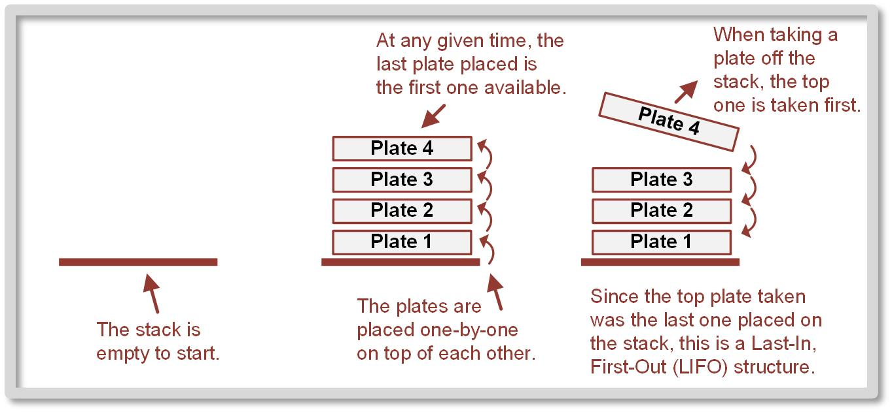
Ch. 10: The STACK and Subroutines
10.1 the Stack
A stack is a last-in, first out (LIFO) storage structure.
10.1 The STACK

Slide 3
Ch. 10: The STACK and Subroutines
10.1 the Stack
Stack – a system that allows us to dynamically allocate data memory.
Dynamically – we can access memory without initializing it or reserving it using assembler directives such as .short and .space.
10.1 The STACK

Slide 4
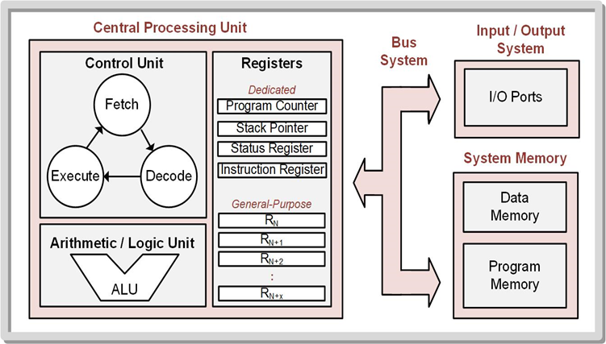
Ch. 10: The STACK and Subroutines
10.1 the Stack
What Physically is the Stack in an MCU?
Storage at the end of data memory & an address pointer.
10.1 The STACK

Slide 5
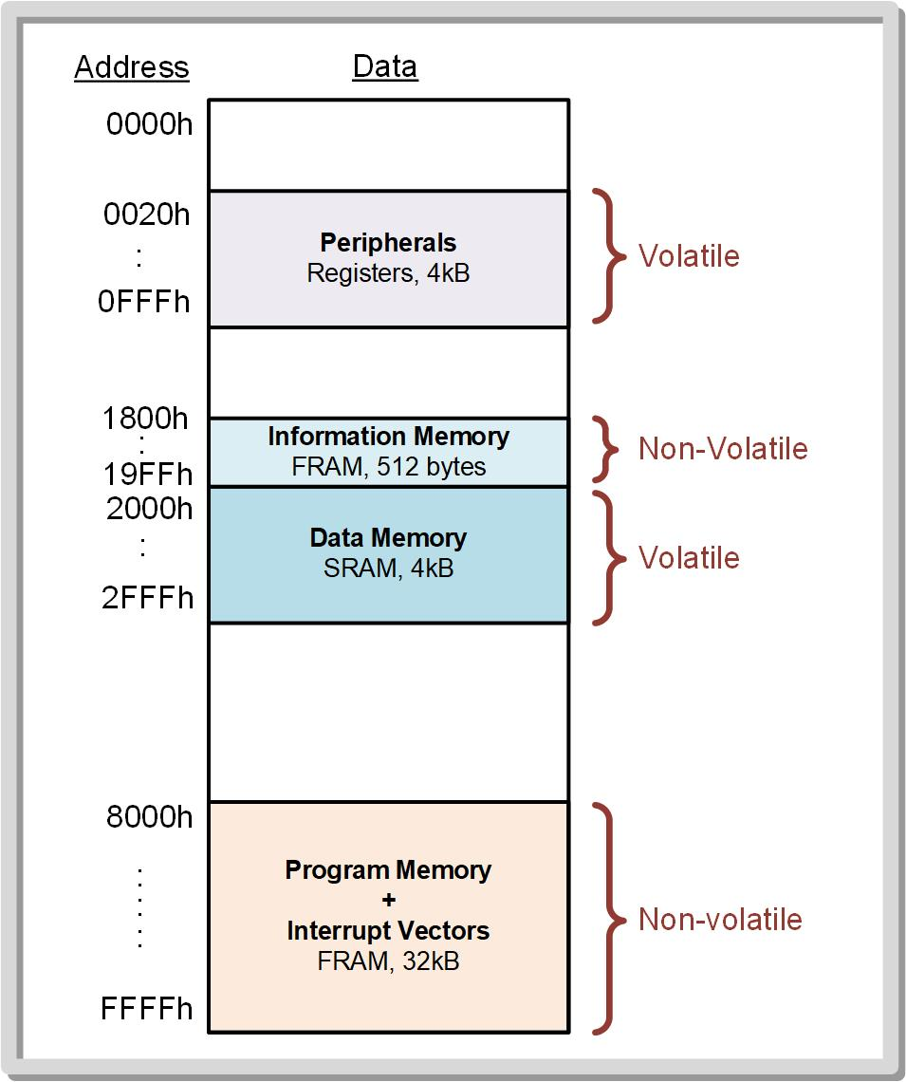
Ch. 10: The STACK and Subroutines
10.1 the Stack
The data memory range in the MSP430FR2355 is from 2000h → 2FFFh.
The stack resides at the end of data memory to allow the maximum potential size of the stack and also avoids overriding reserved locations in memory that are placed at the beginning address of data memory (i.e., 2000h).
SP
10.1 The STACK

Slide 6
Ch. 10: The STACK and Subroutines
10.1 the Stack
SP is initialized to 3000h.
This means that the first 16-bit word of information pushed will be stored at address 2FFEh.
This is accomplished using a move instruction and a global constant called __STACK_END.
SP
10.1 The STACK

Slide 7
Ch. 10: The STACK and Subroutines
10.1 the Stack
Push = Put Data on Stack - decrement SP - dst → @SP
Pop = Get Data from Stack - increment SP - mov src, @SP
SP
10.1 The STACK

Slide 8
Ch. 10: The STACK and Subroutines
10.1 the Stack
Push = Put Data on Stack - decrement SP - dst → @SP - .w: SP – 2 → SP
Pop = Get Data from Stack - increment SP - mov src, @SP - .w: SP + 2 → SP
SP
10.1 The STACK

Slide 9
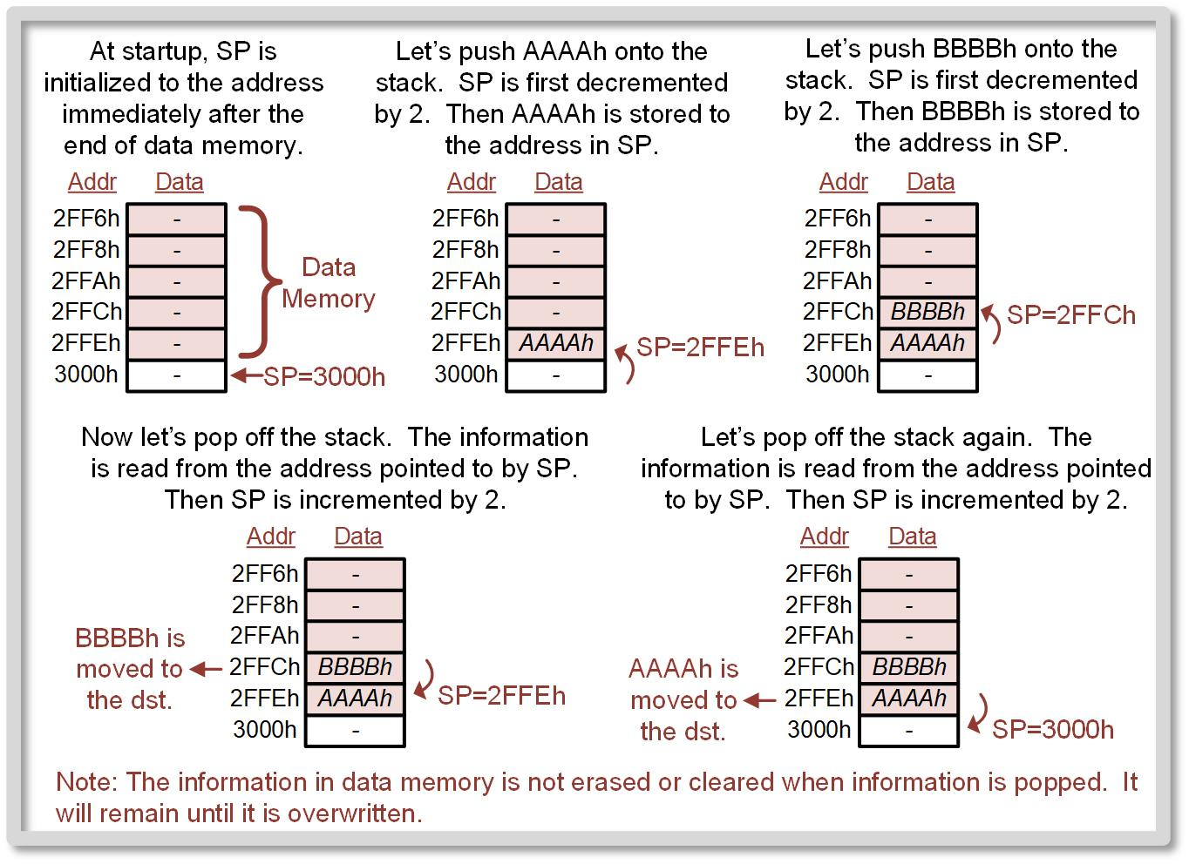
Ch. 10: The STACK and Subroutines
10.1 the Stack
10.1 The STACK

Slide 10
Ch. 10: The STACK and Subroutines
10.1 the Stack
STACK Overflow
When pushes start overwriting other locations in memory.
SP
10.1 The STACK

Slide 11
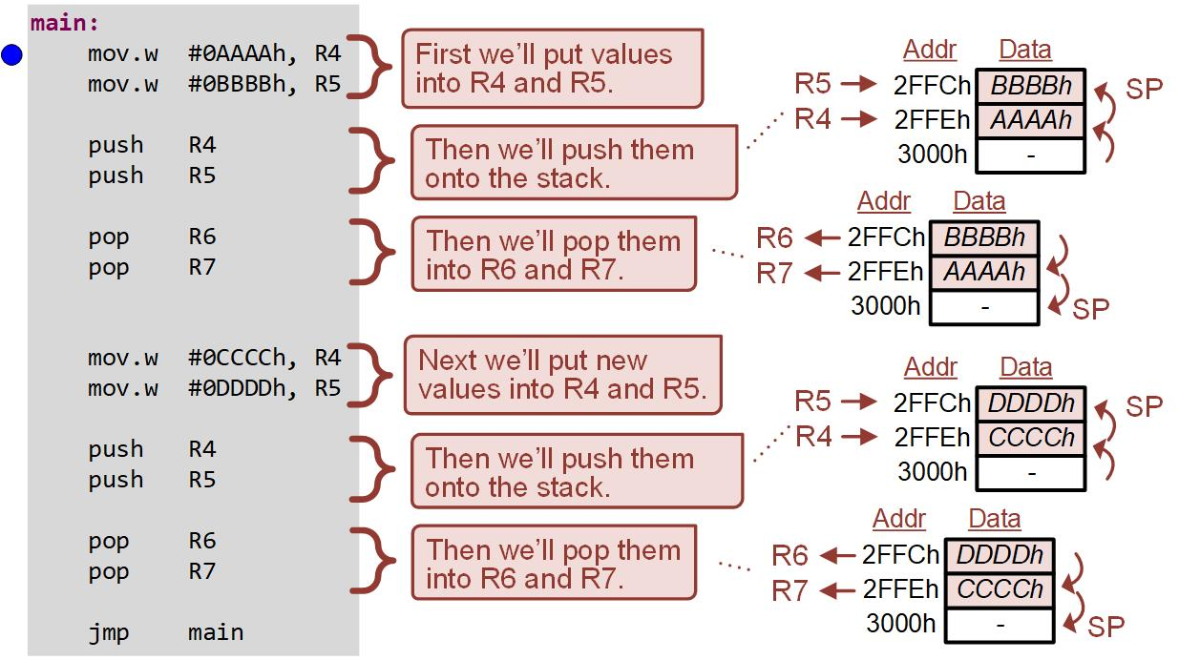
Ch. 10: The STACK and Subroutines
Example: Using the Stack
10.1 The STACK

Slide 12

Ch. 10: The STACK and Subroutines
Example: Using the Stack
Step 1: Create a new Empty Assembly-only CCS project titled:
Asm_Stack
Step 2: Type in the following code into the main.asm file where the comments say “Main loop here.”
Image Courtesy of https://neodem.wp.horizon.ac.uk/
Image Courtesy of
Recording Connection of Canada
Image Courtesy of
Recording Connection of Canada
Image Courtesy of
Recording Connection of Canada
Image Courtesy of
Recording Connection of Canada
10.1 The STACK

Slide 13
Ch. 10: The STACK and Subroutines
Example: Using the Stack
Step 3: Debug your program.
Step 4: Run your program to the breakpoint.
Step 5: Open the Register Viewer so that you can see SP and R4 → R7. Open the Memory Browser and go to 0x3000. Then scroll up so you can see the values 2FFEh and 2FFCh.
Image Courtesy of https://neodem.wp.horizon.ac.uk/
Image Courtesy of
Recording Connection of Canada
Image Courtesy of
Recording Connection of Canada
Image Courtesy of
Recording Connection of Canada
Image Courtesy of
Recording Connection of Canada
10.1 The STACK

Slide 14
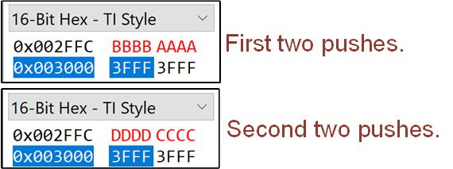
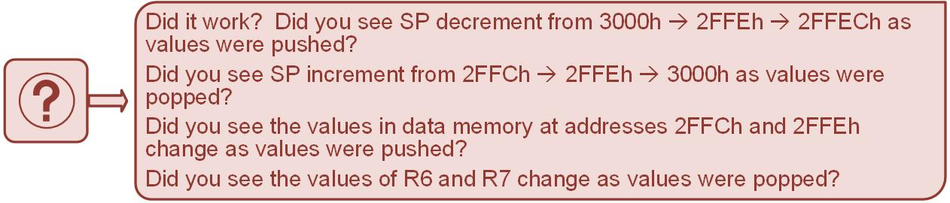
Ch. 10: The STACK and Subroutines
Example: Using the Stack
Step 6: Step your program. As you step, look at the values of SP and the values in data memory before 0x3000. In the Memory Browser you should see the following as the values are pushed.
10.1 The STACK

Slide 15

Embedded Systems Design
Chapter 10: The STACK and Subroutines
10.1 The STACK
www.youtube.com/c/DigitalLogicProgramming_LaMeres
Brock J. LaMeres, Ph.D.

Slide 16
Embedded Systems Design
Chapter 10: The STACK and Subroutines
10.2 Subroutines
Brock J. LaMeres, Ph.D.

Slide 17
Ch. 10: The STACK and Subroutines
10.2 Subroutines
Subroutine – a piece of code that will be used repeatedly in a program; typically accomplishes a very specific task.
The subroutine code is implemented only once outside the main program loop. This creates a more efficient and simple program to read.
Other names for subroutines: procedures, functions, routines, methods, subprograms.
Main Program
Subroutine 1
Subroutine 2
10.2 Subroutines

Slide 18
Ch. 10: The STACK and Subroutines
10.2 Subroutines
Whenever the subroutine is needed, it can be executed by jumping to it.
Once the subroutine completes, a return jump is used to move the PC back to the next location in the main program loop to continue operation.
Main Program
Subroutine 1
Subroutine 2
10.2 Subroutines

Slide 19
Ch. 10: The STACK and Subroutines
10.2 Subroutines
A subroutine starts with an address label to mark its location in memory.
Additional steps must be taken when jumping to a subroutine because while the starting address of the subroutine is always the same, the return address in the main program will vary depending on where in the main program it is called.
Main Program
Subroutine 1
Subroutine 2
10.2 Subroutines

Slide 20
Ch. 10: The STACK and Subroutines
10.2 Subroutines
Call – instruction that is used to jump to the subroutine address label and handles storing the return address on the stack prior to jumping to the subroutine address.
Ret – instruction used at the end of the subroutine that pops the return address off the stack and places it into PC to return to the main program.
Main Program
Subroutine 1
Subroutine 2
10.2 Subroutines

Slide 21
Ch. 10: The STACK and Subroutines
10.2 Subroutines
Variables can be passed to subroutines using three different approaches:
Using the CPU registers
Using the stack
Using dedicated variables in data memory
Image Courtesy of https://neodem.wp.horizon.ac.uk/
Image Courtesy of
Recording Connection of Canada
Image Courtesy of
Recording Connection of Canada
Image Courtesy of
Recording Connection of Canada
Image Courtesy of
Recording Connection of Canada
10.2 Subroutines

Slide 22
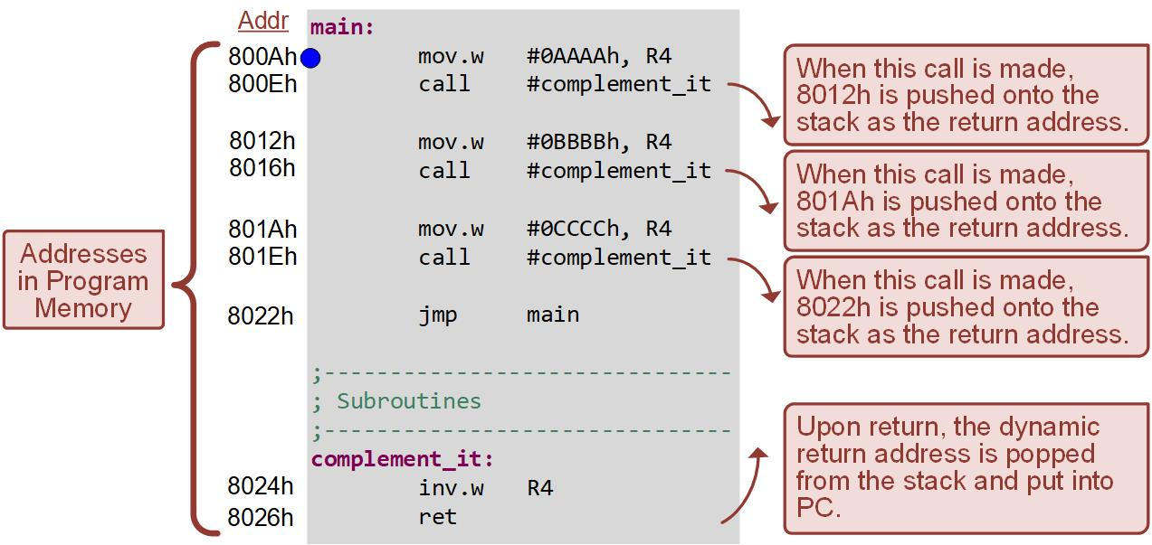
Ch. 10: The STACK and Subroutines
Example: Using Subroutines
10.1 The STACK

Slide 23
Ch. 10: The STACK and Subroutines
Example: Using Subroutines
Step 1: Create a new Empty Assembly-only CCS project titled:
Asm_Subroutines
Step 2: Type in the following code into the main.asm file where the comments say “Main loop here.”
Image Courtesy of https://neodem.wp.horizon.ac.uk/
Image Courtesy of
Recording Connection of Canada
Image Courtesy of
Recording Connection of Canada
Image Courtesy of
Recording Connection of Canada
Image Courtesy of
Recording Connection of Canada
10.2 Subroutines

Slide 24
Ch. 10: The STACK and Subroutines
Example: Using Subroutines
Step 3: Debug your program.
Step 4: Run your program to the breakpoint.
Step 5: Open the Register Viewer so that you can see PC, SP, and R4. Open the Memory Browser and go to 0x3000. Then scroll up so you can see the first location on the stack (address 2FFEh).
Image Courtesy of https://neodem.wp.horizon.ac.uk/
Image Courtesy of
Recording Connection of Canada
Image Courtesy of
Recording Connection of Canada
Image Courtesy of
Recording Connection of Canada
Image Courtesy of
Recording Connection of Canada
10.1 The STACK

Slide 25
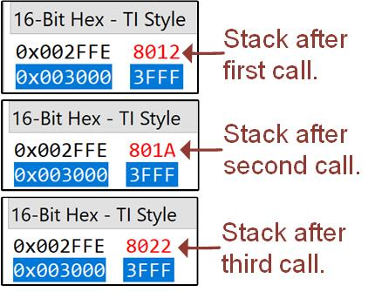
Ch. 10: The STACK and Subroutines
Example: Using Subroutines
Step 6: Step your program using Step Into. As you step, look at the values of PC, SP, and the values in data memory for the stack. In the Memory Browser you should see the following as the values are pushed.
Step 7: Now step your program using Step Over. This time when you step you’ll see the program still executes the subroutine, but it doesn’t move into the subroutine code. This is the first time we have been able to use step over.
10.1 The STACK

Slide 26
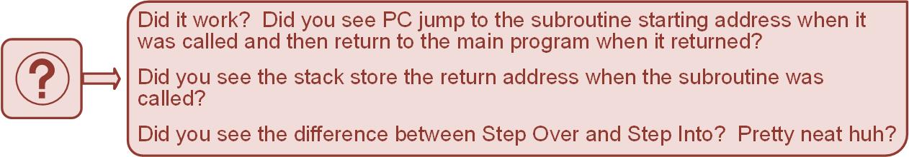
Ch. 10: The STACK and Subroutines
Example: Using Subroutines
Image Courtesy of https://neodem.wp.horizon.ac.uk/
Image Courtesy of
Recording Connection of Canada
Image Courtesy of
Recording Connection of Canada
Image Courtesy of
Recording Connection of Canada
Image Courtesy of
Recording Connection of Canada
10.1 The STACK

Slide 27
Embedded Systems Design
Chapter 10: The STACK and Subroutines
10.2 Subroutines
www.youtube.com/c/DigitalLogicProgramming_LaMeres
Brock J. LaMeres, Ph.D.

